Slide 1
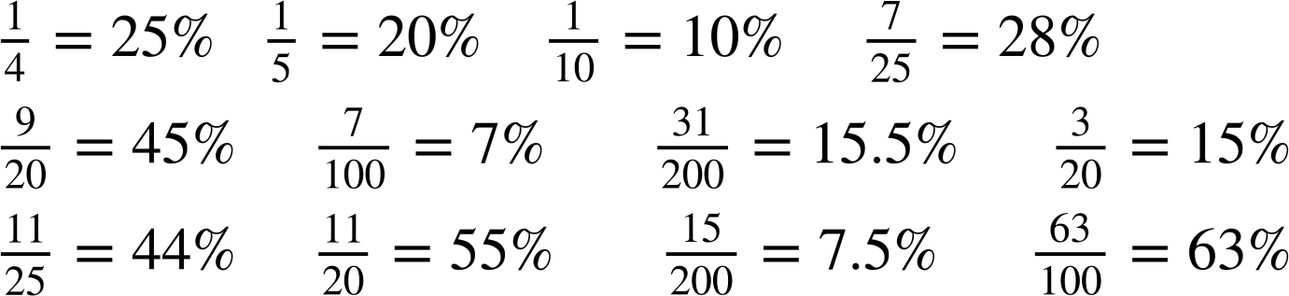

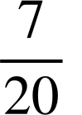
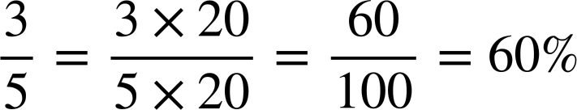
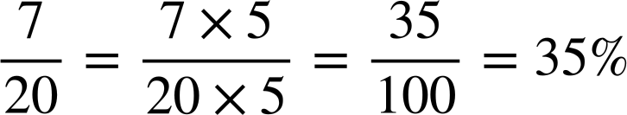
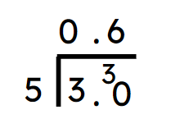
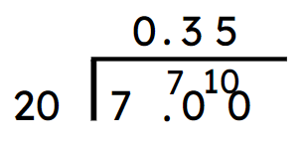


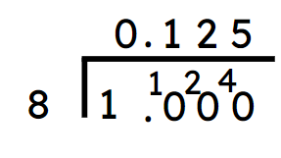
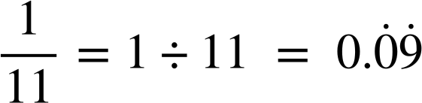
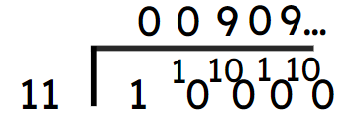


Expressing one number as a percentage of another
Task A: Writing any fraction as a percentage
Only shade in the equivalent percentages of the following fractions.
25% | 20% | 5% | 31% | 11% | 15%
10% | 20% | 17% | 5% | 15.5% | 17%
2% | 8% | 13% | 7% | 8% | 5%
31% | 4% | 45% | 14% | 6% | 8%
29% | 28% | 23% | 11% | 44% | 55%
10% | 21% | 59% | 3% | 7.5% | 63%
2) Convert the following fractions into a percentage. Give your answers correct to 1 decimal place if needed.
a) b)
c) d)

Slide 2
Expressing one number as a percentage of another
Task B: Writing any number as a percentage of another
Work out the following, giving your answer to 2 d.p. where appropriate:
21 as a percentage of 25
60 as a percentage of 80
84 as a percentage of 240
81 as a percentage of 240
37 as a percentage of 60
19 as a percentage of 40
84%
75%
35%
33.75%
61.67% (2 d.p.)
47.5%
2) Laura is ill and misses her first day of school.
a) What is her percentage attendance after day one?
Laura is better the next day and attends school.
b) What is her percentage attendance after day two?
Laura attends the rest of that week and all of the next week.
c) What is her percentage attendance after day five?
d) What is her percentage attendance after day ten?
0%
50%
80%
90%
Laura says that she will need to attend every day for the rest of the year to get 100% attendance.
e) Is Laura correct? Why or why not?
No, Laura is not correct – she cannot get 100% attendance for the year, as she has already missed a day.
The highest Laura’s attendance can be is 99% (as 189 ÷ 190 × 100 = 99.473684…). The lowest Laura’s attendance could be is 5% (as 9 ÷ 190 × 100 = 4.736842…)
Mathematics in Education and Industry.
v2.3

